Slide 1

Detecting Hate Speech in Memes
Team No : E5
Guide:
Dr P.G. Sunitha Hiremath
TEAM Members
Varun Bohara 01fe18bcs278
Sakshi Tahlani 01fe18bcs271
Abhishek Rao 01fe18bcs297
Madhurika Ganiger 01fe18bcs284
<number>

Slide 2
Project Overview / Summary
Domain/Problem Space :
( Short description of domain & importance
– Max 2 to 3 bullets / short sentences )
Goals / Objectives :
( Specific description of KPI being attempted
– provide numerical values wrt targets )
Multimodal data
To generate vector embeddings of image and text.
To fuse the text and image embeddings and build a classifier.
To evaluate the performance of the multimodal architecture.
To compare proposed architecture with SOTA techniques.
Problem Definition :
( Clear description of problem given
– Max 2 to 3 bullets / short sentences )
Technical Challenges :
( List top 2 - 3 technical challenges to overcome
- Short & Crisp, in bullet form not big sentence )
Given the multimodal data consisting of meme images and text, we develop a multimodal architecture which classifies the memes as hateful or non hateful.
Competence in the domain.
Computing resource is not adequate.
Notes:
6

Slide 3
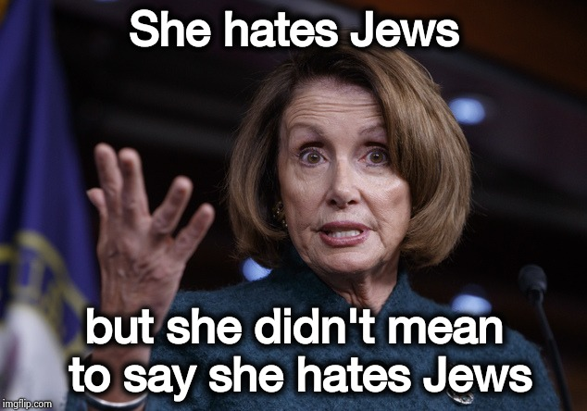
Proposed system / Solution
Input
She hates Jews but she didn't
mean to say she hates Jews
Text embedding
Multimodal fusion
Performance Evaluation
Visual embedding
Hateful/Non-Hateful
Output
3
Notes:
6

Slide 4
Dataset details
Dataset Source / Features/ Generation :
Dataset suitability/ analysis :
Source : Hosted by Facebook (Datase size : train = 8500 , test_seen = 1000 , test_unseen = 1000, dev_seen = 500 , dev_unseen = 540)
Features : Images and text.
Labels : Hateful, Non hateful.
Dataset has 40% multimodal hate, 10% unimodal hate, 20% benign text confounder, 20% benign image confounder and 10% random non-hateful.
Provided images are of different sizes.
[ Example : (265, 400), (800, 533) ]
Notes:
6

Slide 5
Expected Results / measurable Outputs/
Key performance indicators :
To obtain the accuracy > 80 percent
Major novelty / Observations / Conclusions :
This work proposes a new challenge set for multimodal classification, focusing on detecting hate speech in multimodal memes. .
Notes:
6

Slide 6
Plan to Complete Project
Final Probable Deliverables :
System which classifies memes as hateful or non-hateful
IP Target / Plan / competitions:
( Any possibility of papers / patentable ideas / participation into competitions )
Completion Plan :
( High level plan to complete the project in next 8 weeks after review, in format below )
Week 1 to 4
Study the domain and literature survey
Week 5 to 8
Propose and implement the embeddings
Intermediate result analysis and improvement
Week 9 to 12
Implementing the fusion and classification
Result analysis and improvements
Week 13 to 16
Compare with SOTA and improve results
Report writing
Notes:
<number>

